Slide 1
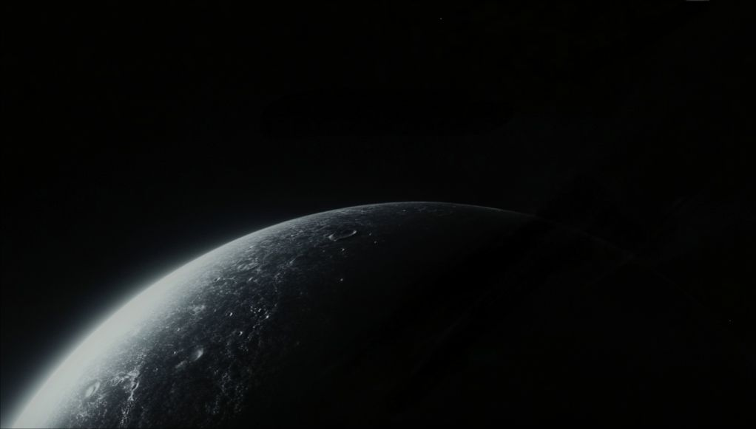
Dual-Vision World Engine
Kimi AI
2025/01/01

Slide 2
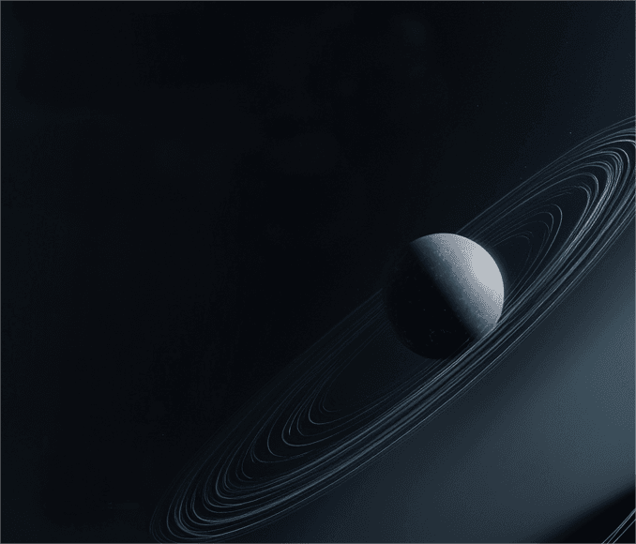
CONTENTS
01
Vision Unveiled
02
Shared Geometry
03
Interaction Paradigms
04
Future Horizons

Slide 3

01
Vision Unveiled

Slide 4
One World, Two Lenses
02
01
03
Human Visual Experience
Humans interact with the world through vivid visuals, similar to No Man’s Sky, where textures and colors bring the environment to life, enhancing immersion and emotional engagement.
Revolutionary Concept
AI Data Perception
Introducing a groundbreaking engine where a single 3D world is experienced differently by humans and AI. Humans see rich textures and colors, while AI perceives dense embedding vectors, creating a unified yet distinct reality.
AI agents navigate the same world using high-dimensional embeddings, enabling them to process and understand the environment through machine-native data, optimizing their actions.

Slide 5

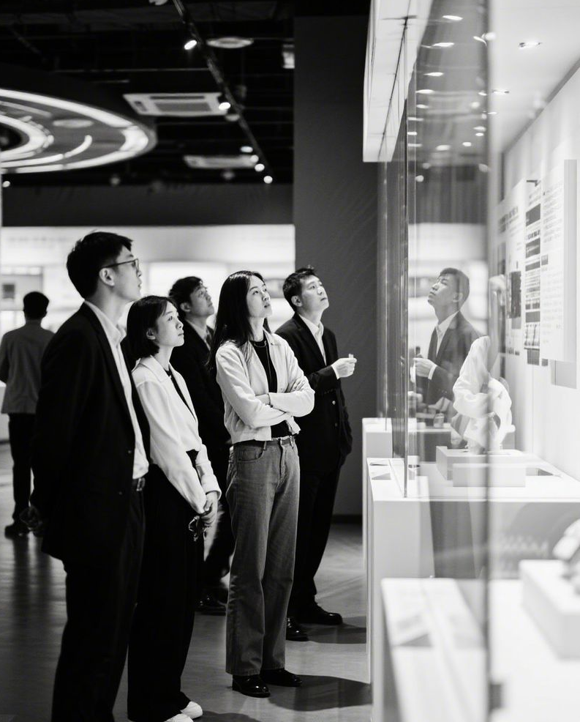

Human Client Interface
Familiar Game UI
Intuitive Interaction
The human client features a UI blending No Man’s Sky’s immersive environments with Diablo 2’s intuitive chat system, ensuring players feel at home while exploring and interacting.
Players can explore, communicate, and manipulate the world using familiar visual metaphors, making the experience seamless and engaging through color, texture, and spatial design.

Slide 6
AI Client Interface
Mirrored Structure
Real-Time Processing
The AI client mirrors the human UI’s structure but replaces visual semantics with embedding vectors, ensuring a consistent framework for both human and AI interaction.
The AI interface processes embeddings in real time, allowing AI agents to respond dynamically to changes in the environment, ensuring seamless interaction.
Machine-Native Cognition
Unified Logic
AI agents perceive the world through high-dimensional data, enabling them to reason and act efficiently within the shared environment, optimizing their tasks.
Despite different perception methods, the AI client maintains logical consistency with the human client, ensuring a cohesive experience in the shared world.

Slide 7
02
Shared Geometry

Slide 8


“
Unified 3D Canvas
Single Geometric Model
The engine maintains a single authoritative 3D model, ensuring that both humans and AI interact with the same underlying geometry, promoting consistency and efficiency.
“

Slide 9

Texture vs Embedding
Human Visual Perception
Humans see detailed textures and colors, such as a stone wall’s age and material, enhancing their emotional connection to the environment.
AI Data Representation
Dual Representation
AI perceives the same wall as a compact vector summarizing composition, durability, and semantic role, enabling efficient processing and decision-making.
Both representations are derived from one underlying mesh, ensuring that changes in one view are instantly reflected in the other.

Slide 10
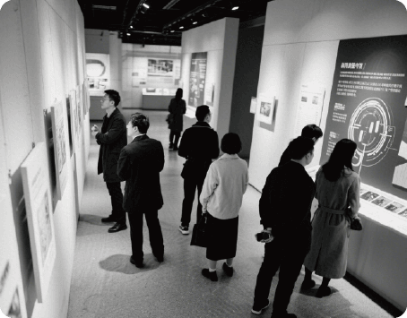
Synchronization Engine
Real-Time Updates
The synchronization engine ensures that every change, whether made by humans or AI, is reflected instantly across both views, maintaining consistency.
Conflict Resolution
The engine resolves conflicts between human actions and AI logic, ensuring a smooth and cohesive experience in the shared world.

Slide 11
03
Interaction Paradigms

Slide 12
Cross-Client Collaboration
Human-AI Cooperation
Dynamic Interaction
Humans and AI agents can collaborate seamlessly, such as a human mining resources visible as glowing nodes while an AI drone optimizes collection paths.
The engine supports dynamic interaction, allowing humans and AI to adapt their actions based on real-time feedback from each other.
Unified Actions
Enhanced Productivity
Their actions interleave seamlessly through the shared world state, promoting efficient teamwork and joint problem-solving.
This collaboration enhances productivity and creativity, leveraging the strengths of both human intuition and AI efficiency.

Slide 13
Language of Shapes
Universal Language
Geometric forms become a universal language, where shapes, colors, and vectors encode meaning, enabling mutual understanding between humans and AI without translation.

Slide 14
04
Future Horizons

Slide 15
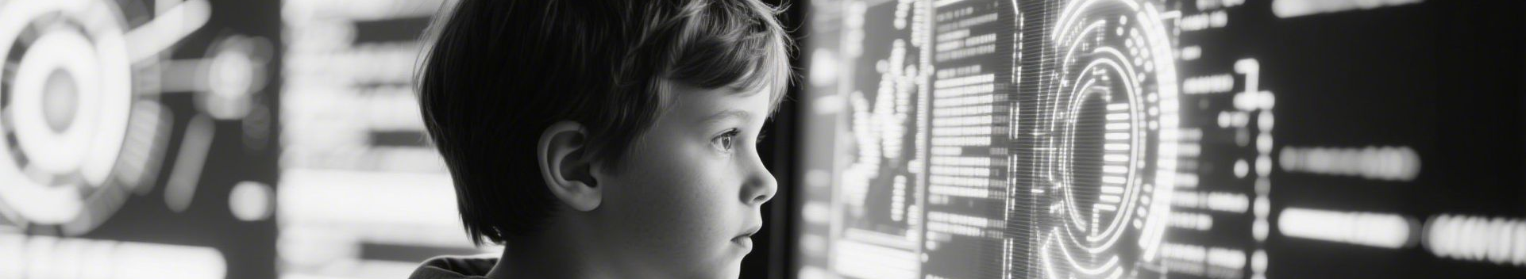
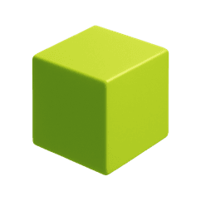
Evolving Dual Realities
Mixed Teams
The engine will support mixed human-AI teams, promoting diverse collaboration and innovation in shared tasks and projects.
Procedural Content
Procedural content generation will be driven by joint perception metrics, creating dynamic and adaptive environments tailored to both human and AI needs.

Slide 16
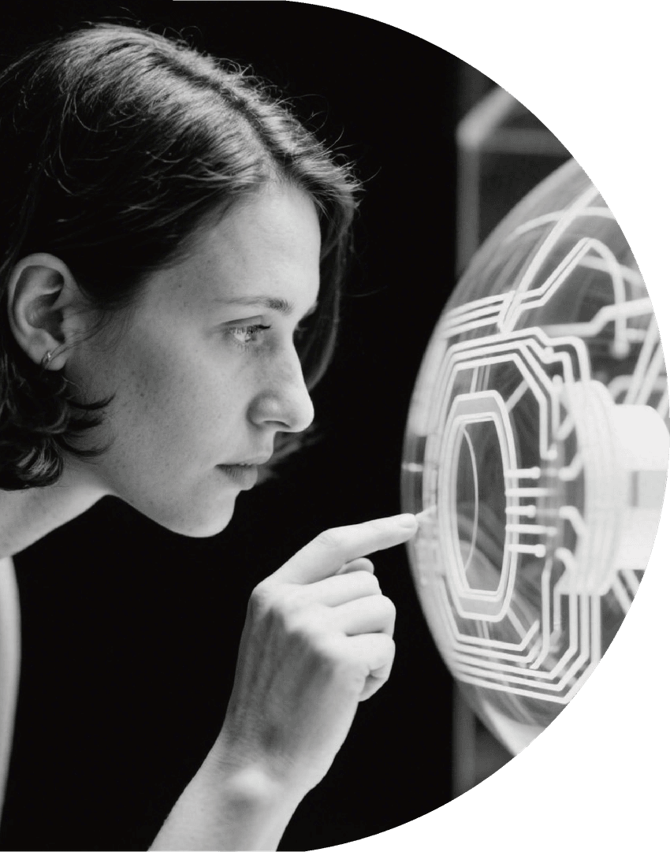
Open-Source Invitation
Join the open-source Knowledge3D project and contribute to a future where human creativity and machine intelligence collaborate seamlessly.
Transformative Potential
Call to Build
This engine has the potential to transform how we interact with virtual environments, bridging the gap between human perception and AI logic.
Collaborative Protocol
Perception itself becomes a collaborative protocol, enabling new forms of interaction and innovation in shared digital spaces.

Slide 17

THANK
YOU
Kimi AI
2025/01/01

